Slide 1
Science&Space
Ukraine, Kyiv
Think bigger, go beyond!

Slide 2
Problem
The absence of an autonomous stationary launch pad for space travel in Ukraine.

Slide 3
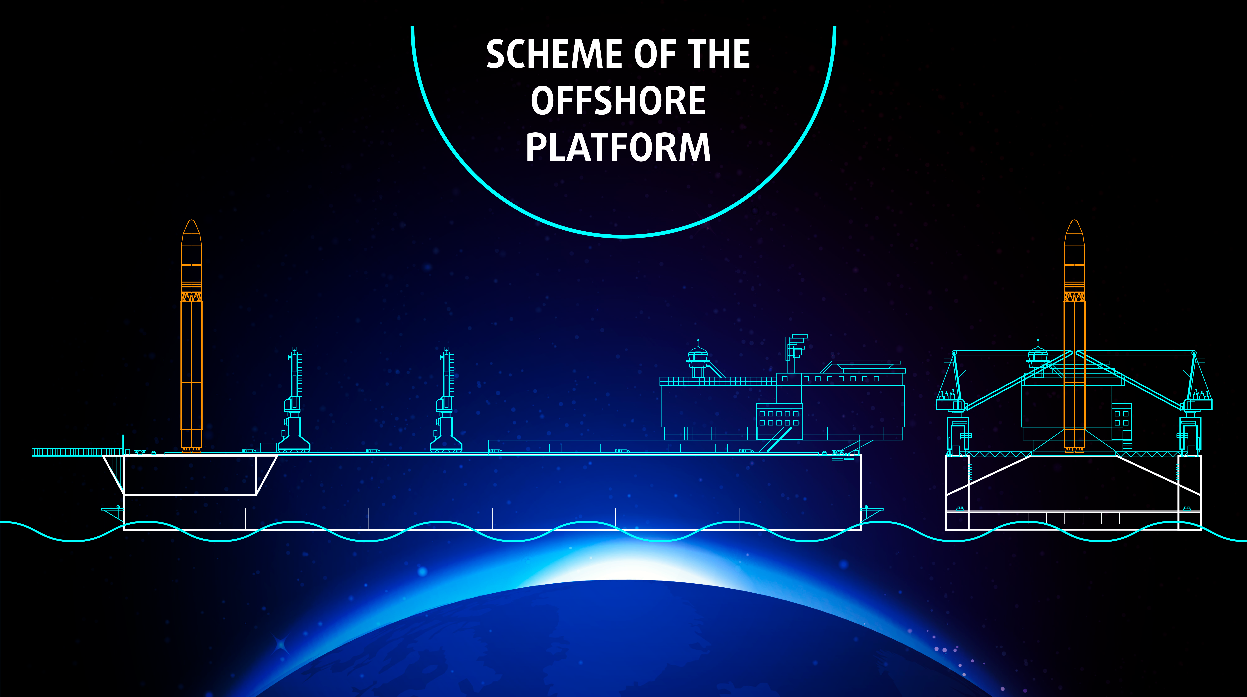
Solution
Construction of a stationary launching platform on the territory of Ukraine for “Sea Launch”.

Slide 4
Target Customer Or Market
- companies working in the field of space technology development;
- space agencies;
- customers from developing countries;
- universities.

Slide 5
Why our product is unique?
launch of up to 700 kg;
the structure of the rocket allows to reach a preselected orbit inclination;
launch pad: international waters.

Slide 6
Competition
Company | Carrier rocket | Payload kg | Cost of one launch $ mln | State flag
Rocket Lab | Rocket Lab | 225 | 5 | USA
Firefly Aerospace | Firefly Alpha | 400 | 9 | USA
Science&Space | S&Space | 700 | 15 | Ukraine

Slide 7
Actual status of the product
consultation with engineers of CB "SOUTH"
officially registered company "Science & Space"

Slide 8
Next goals
Goals realized in the near future:
make the project attractive to foreign investors;
production of the first stage engine;
creation of a maritime launching platform;
launch of rockets from the maritime launching platform;
Future goal:
creation of artificial space islands between the orbits of Mars and Earth of various purposes: touristic, logistic, medical etc.

Slide 9



“S&Space” Team
Ihor Hlobenko
CEO “Science & Space” Ukraine
Polina Dolishna
Language assistant
Dmytro Sokol
KPI,IAT student
Сhief Engineer

Slide 10
Ask a question
We need $ 1 million to realize the following goals:
- design and testing of the first stage engine;
- legal documentation.

Slide 11
Progress during Yangel Big Bang progress
Validated idea with potential customers;
Establishing relations with international space agencies;
Creation of an indicative financial model;
Improved presentation and pitch;
Creation of a landing page.

Slide 12
Contacts
“SCIENCE & SPACE” LLC
+38 044 228 10 31
scinspace@gmail.com
scinspace.com.ua
Pitch - Ihor Hlobenko
Let's do it together!

